Slide 1
COMP6049 – Algorithm Design and Analysis
Topic 14 – Dynamic Programming: Multistage Graph

Slide 2
Outline Materials
Multistage Graph problem
Forward technique
Backward technique

Slide 3
MULTISTAGE GRAPH
Multistage Graph is a graph with special characteristics:
Directed Graph
Each edge has weight
Has only 1 source (called as s) and 1 sink (called as t)
Path from source to sink consists some stages V₁ to V_{k}
All stages connect node in V_{i} to node V_{i+1} where 1 ≤ i ≤ k
There are k stages, where k ≥ 2
Each path from s to t is consequence of choice k-2.
Multistage Graph is a modeling that can be used to solve some real problems.
Example: choosing project to get maximum profit; including selecting steps to perform each task.

Slide 4
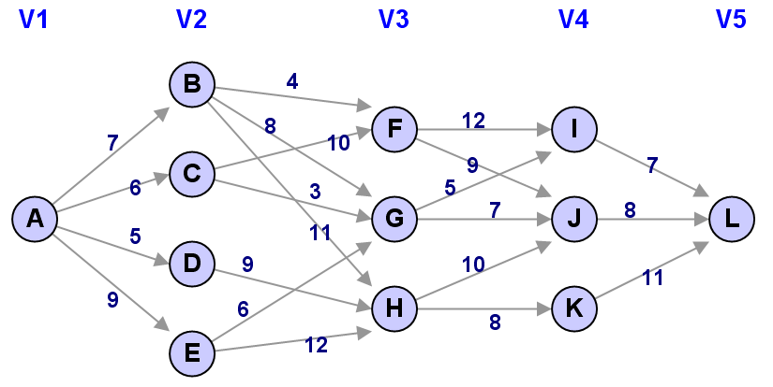
MULTISTAGE GRAPH PROBLEM
Multistage Graph Problem :
Sortest path finding problem from source to sink in Multistage Graph.
The problem is one of good implementation of Dynamic Programming.

Slide 5
DP IN MULTISTAGE GRAPH PROBLEM
Solving of Multistage Graph problem using Dynamic Programming in shortest path from a node to another is a shortest path of previous stage added by distance of one of an edge connects to a stage.
Forward Method
Calculate distance to front (to sink)
Backward Method
Calculate distance to back (from source)

Slide 6
FORWARD METHOD
Analysis by calculating path from a node to sink
Formula: cost(i,j) = min{c(j,k) + cost(i+1,k)}
Calculation starts from nodes in stage k-2
cost(i,j) is distance of path from node j in stage i to sink(t)
c(j,l) is distance of path from node j to node l

Slide 7
FORWARD METHOD
cost(4,I) = c(I,L) = 7
cost(4,J) = c(J,L) = 8
cost(4,K) = c(K,L) = 11
cost(3,F) = min { c(F,I) + cost(4,I) | c(F,J) + cost(4,J) }
cost(3,F) = min { 12 + 7 | 9 + 8 } = 17
cost(3,G) = min { c(G,I) + cost(4,I) | c(G,J) + cost(4,J) }
cost(3,G) = min { 5 + 7 | 7 + 8 } = 12
cost(3,H) = min { c(H,J) + cost(4,J) | c(H,K) + cost(4,K) }
cost(3,H) = min { 10 + 8 | 8 + 11 } = 18
cost(2,B) = min { c(B,F) + cost(3,F) | c(B,G) + cost(3,G) | c(B,H) + cost(3,H) }
cost(2,B) = min { 4 + 17 | 8 + 12 | 11 + 18 } = 20
cost(2,C) = min { c(C,F) + cost(3,F) | c(C,G) + cost(3,G) }
cost(2,C) = min { 10 + 17 | 3 + 12 } = 15
cost(2,D) = min { c(D,H) + cost(3,H) }
cost(2,D) = min { 9 + 18 } = 27
cost(2,E) = min { c(E,G) + cost(3,G) | c(E,H) + cost(3,H) }
cost(2,E) = min { 6 + 12 | 12 + 18 } = 18
cost(1,A) = min { c(A,B) + cost(2,B) | c(A,C) + cost(2,C) | c(A,D) + cost(2,D) | c(A,E) + cost(2,E) }
cost(1,A) = min { 7 + 20 | 6 + 15 | 5 + 27 | 9 + 18 } = 21
Shortest path is A-C-G-I-L with distance 21

Slide 8
BACKWARD METHOD
Analysis by calculating path from source to a node
Formula: bcost(i,j) = min{bcost(i–1,l) + c(l,j)}
Calculation starts from nodes in stage 3
bcost(i,j) is distance of path backward from source (s) to node j in stage i
c(j,l) is distance of path from node j to node l

Slide 9
METODE BACKWARD
bcost(2,B) = c(A,B) = 7
bcost(2,C) = c(A,C) = 6
bcost(2,D) = c(A,D) = 5
bcost(2,E) = c(A,E) = 9.
bcost(3,F) = min { c(B,F) + bcost(2,B) | c(C,F) + bcost(2,C) }
bcost(3,F) = min { 4 + 7 | 10 + 6 } = 11
bcost(3,G) = min { c(B,G) + bcost(2,B) | c(C,G) + bcost(2,C) | c(E,G) + bcost(2,E) }
bcost(3,G) = min { 8 + 7 | 3 + 6 | 6 + 9 } = 9
bcost(3,H) = min { c(B,H) + bcost(2,B) | c(D,H) + bcost(2,D) | c(E,H) + bcost(2,E) }
bcost(3,H) = min { 11 + 7 | 9 + 5 | 12 + 9 } = 14
bcost(4,I) = min { c(F,I) + bcost(3,F) | c(G,I) + bcost(3,G) }
bcost(4,I) = min { 12 + 11 | 5 + 9 } = 14
bcost(4,J) = min { c(F,J) + bcost(3,F) | c(G,J) + bcost(3,G) | c(H,J) + bcost(3,H) }
bcost(4,J) = min { 9 + 11 | 7 + 9 | 10 + 14 } = 16
bcost(4,K) = min { c(H,K) + cost(3,H) }
bcost(4,K) = min { 8 + 14 } = 22
bcost(5,L) = min { c(I,L) + bcost(4,I) | c(J,L) + bcost(4,J) | c(K,L) + bcost(4,K) }
bcost(5,L) = min { 7 + 14 | 8 + 16 | 11 + 22 } = 21
Shortest path is A-C-G-I-L with distance 21

Slide 10
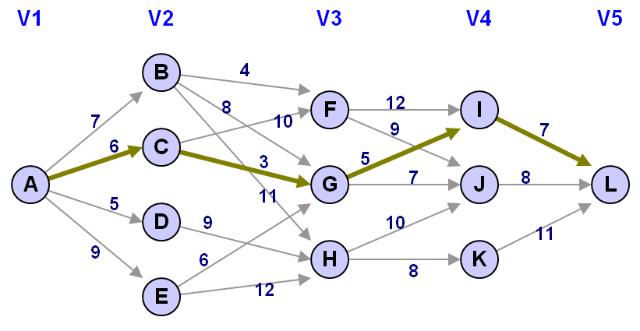
SHORTEST PATH IN MULTISTAGE GRAPH

Slide 11
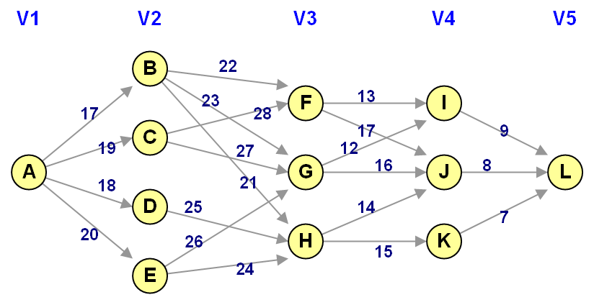
EXERCISE
Find shortest path from node A to node L using Dynamic Programming (forward method and backward method) !

Slide 12
REVIEW
MULTISTAGE GRAPH
MULTISTAGE GRAPH PROBLEM
DINAMIC PROGRAMMING IN MULTISTAGE GRAPH
FORWARD METHOD AND BACKWARD METHOD

Slide 13
Q & A

Slide 14
References
S. Sridhar. 2014. Design and Analysis of Algorithms, 1/e. Oxford University Press. India. Chapter 13
Ellis Horowitz,Sanguthevar Rajasekaran,Sartaj Sahni. 1998. Computer algorithms/C++. 1STBL. New York. Chapter 5.2
Multistage Graphs http://www.cs.oswego.edu/~odendahl/coursework/csc465/notes/09-c-multistage.html

Slide 15
THANK YOU

